Slide 1
Digital Portfolio
STUDENT NAME:
REGISTER NO AND NMID:
DEPARTMENT:
COLLEGE: COLLEGE/ UNIVERSITY

Slide 2
PROJECT TITLE

Slide 3


AGENDA
Problem Statement
Project Overview
End Users
Tools and Technologies
Portfolio design and Layout
Features and Functionality
Results and Screenshots
Conclusion
Github Link
3/21/2024 Annual Review

Slide 4

PROBLEM STATEMENT

Slide 5

PROJECT OVERVIEW
Many students and professionals struggle to present their skills, projects, and contact information in a clear, attractive, and accessible way online. This project aims to create a simple, responsive, and interactive digital portfolio that showcases my background, skills, projects, and contact details effectively.

Slide 6

WHO ARE THE END USERS?

Slide 7

TOOLS AND TECHNIQUES

Slide 8
POTFOLIO DESIGN AND LAYOUT

Slide 9
FEATURES AND FUNCTIONALITY

Slide 10
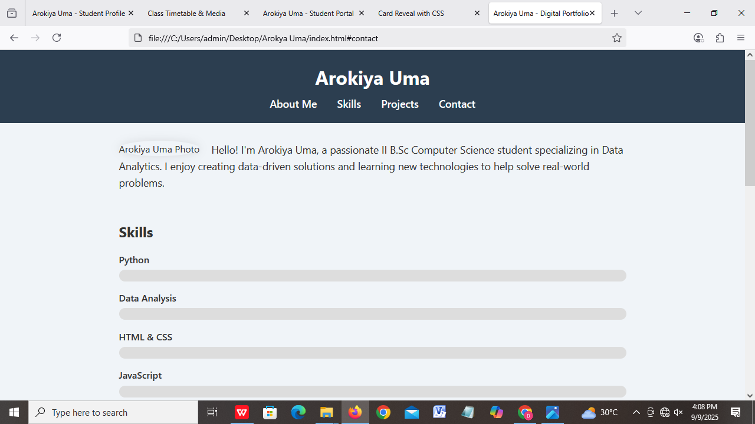

RESULTS AND SCREENSHOTS
3/21/2024 Annual Review

Slide 11
CONCLUSION

